Slide 1
de Brujin graph

Slide 2
What is a de Brujin graph
A de Brujin graph is a data structure that can efficiently represent a read sequence in terms of k-mers.

Slide 3
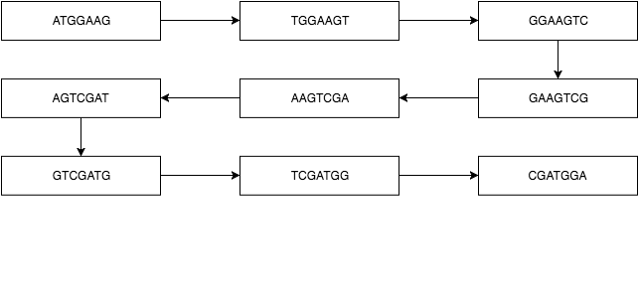
Example
Lets take the following sequence into consideration: ATGGAAGTCGATGGA.

